Slide 1

Presented By: Parth Desai: IU1841230011 Yash Kakrecha: IU1841230022 Manav Prajapati: IU1841230045 | Final Year IDP Project at INEXTURE Solutions LLP, A 'bad
Guided By: Dr. Nimisha Patel

Slide 2
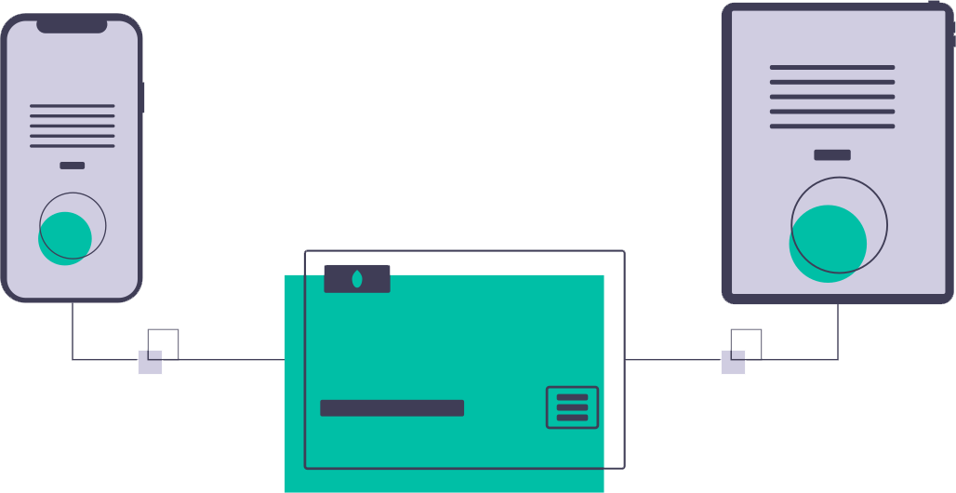
ABOUT
Expense Tracker is a web application for splitting expenses with your friends. It lets you and your friends add various bills and keep track of who owes who, and then it helps you to settle up with each other.
2

Slide 3
OUR PROCESS
1
3

Slide 4
OUR PROCESS
Exploring Analyzing the problem
Designing
User Interface
Testing
1
3
5
2
4
6
Determining the Functionalities & Requirements
Development
Deployment
4

Slide 5
PROBLEMS
2
5

Slide 6

PROBLEMS
Splitting bills on lunch or dinner.
Complex calculation for splitting the bill evenly.
Tough to keep track of debts.
Consumes time for expense calculation.
6

Slide 7
OBJECTIVES
3
7

Slide 8

OBJECTIVES
Maintains the record of your expenses.
Up to date track record of all debts.
Transparent and error free split process.
Time saving from complex calculations.
8

Slide 9
ANALYSIS
4
9

Slide 10
Problems with current systems
Scenario: Let’s say two friends went to supermarket for 5 peoples. One friend focuses on
buying beverages and other Friend focuses on buying vegetables and households.
After purchasing they checkout separately, Now they want splitting as follows:
Fruits and vegetables must be split equally among all.
Beverages must be split among some people let say 3 people equally.
Two person who went for shopping had their personal items.
Some items are shared between some people let say protein powder is to be shared among
only 2 persons.
Then this will become complicated for them to calculate money.
Current systems only provides single split means they can either go with equally split or can go with
Shares split or can go with certain specific split.
10

Slide 11
Problems with current systems
Current system also don’t provide easy UI for user to understand quickly by watching tags and
Advance features like recording each payments, reminder for lent's and debts to be payed, etc.
After successfully splitting bills, one need to make payments. So here many systems uses
Old traditional card payments, while we can use latest ongoing solutions - UPIs like Gpays and
3rd party wallets like paytm.
11

Slide 12
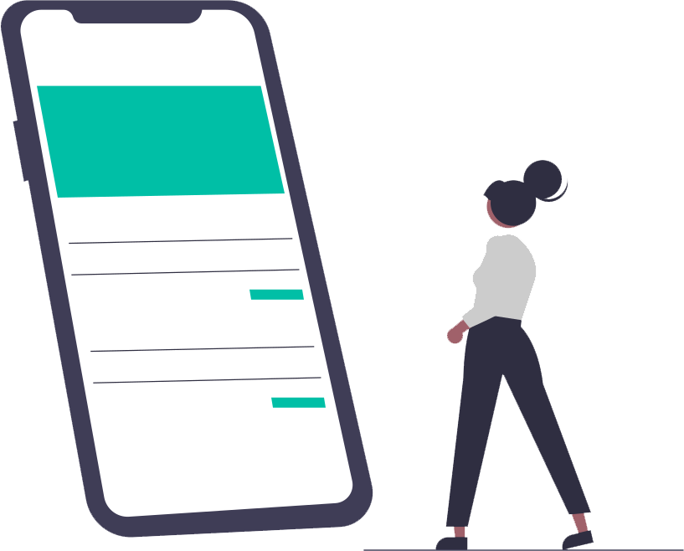
4 Genius Apps for Splitting Bills
1. Splitwise:
Free app
available for iOS and Android
frequently sharing expenses
2. Billr: To Share Costs and Itemize in One.
Not Free app
Available for iOS only.
Instant bill sharing
3. Divvy: To Snap and Split.
Not Free app
available for iOS
Snap and drag features
4. Venmo: To Remind Your Friends They Owe You.
Available for Android only in US
Remind lent and debt
12

Slide 13
TECHNOLOGY
6
13

Slide 14
Technologies we’ll be working on!
HTML
HTML is used to structure a web page and its content. For example, content could be structured within a set of paragraphs, a list of bulleted points, or using images and data tables.
CSS
Cascading Style Sheets (CSS) is a stylesheet language used to describe the presentation of a document written in HTML or XML. CSS describes how elements should be rendered on screen, on paper, in speech, or on other media.
JavaScript
JavaScript is a text-based programming language used both on the client-side and server-side that allows you to make web pages interactive.
Bootstrap
Bootstrap is a Library that focuses on simplifying the development of informative and responsive web pages.
Django
Django is a high-level Python web framework that enables rapid development of secure and maintainable websites and databases.
jQuery
jQuery is an open-sourced JavaScript library that simplifies HTML DOM-manipulation, AJAX and event handling.
14

Slide 15
FIRST VIEW
7
15

Slide 16
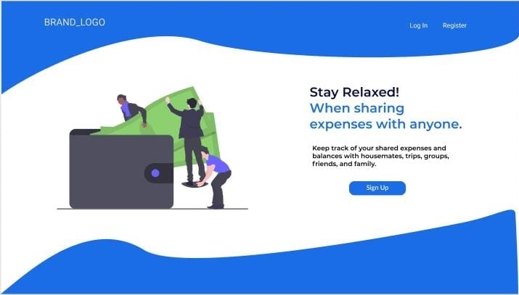
Desktop View
of
16

Slide 17
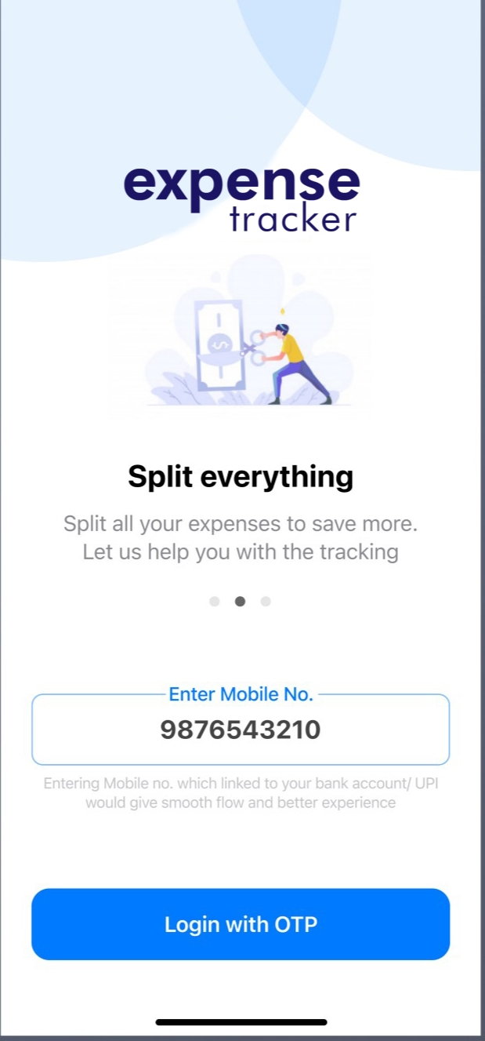
Smartphone View
of
Expense Tracker
17

Slide 18
Application Flow and Data Dictionary
8
18

Slide 19
Application Flow
Dashboard
Create group
Select people for sharing
Spilt amount using different methods
Send notification to peoples for confirmation
Enter amount and choose payer(s)
Settle amount
and payment
(for debts)
After successful payment, Auto-update
View settled expenses
19

Slide 20
Application Flow
Dashboard
Friends tab and Details
List of all friends or groups with lent or debts
Settlement option
List all expenses with specific person or group
View expenses
in charts
Settle amount
and payment
(for debts)
After successful payment, Auto-update
View settled expenses
20

Slide 21
Data Dictionary
Users
Field Name | Data Type | Size | Key
id | IntegerField | Auto-increment | PK
username | CharField | 30 | -
email_address | EmailField | 30 | -
phone | CharField | 10 | -
password | CharField | 20 | -
21

Slide 22
Data Dictionary
Settlements
Field Name | Data Type | Size | Key
id | IntegerField | Auto-increment | PK
user_id | IntegerField | - | FK
bill_id | IntegerField | - | FK
group_id | IntegerField | - | FK
paid | IntegerField | - | -
debt | IntegerField | - | -
must_pay | IntegerField | - | -
22

Slide 23
Data Dictionary
Bills
Field Name | Data Type | Size | Key
id | IntegerField | Auto-increment | PK
name | CharField | 20 | -
date | DateTimeField | - | -
amount | IntegerField | - | -
split_type | CharField | 20 | -
status | CharField | 20 | -
23

Slide 24
Data Dictionary
Groups
Field Name | Data Type | Size | Key
id | IntegerField | Auto-increment | PK
name | CharField | 20 | -
date | DateTimeField | - | -
status | CharField | 20 | -
24

Slide 25
Data Dictionary
Friends
Field Name | Data Type | Size | Key
id | IntegerField | Auto-increment | PK
user_1 | IntegerField | - | FK
user_2 | IntegerField | - | FK
group_id | IntegerField | - | FK
status | CharField | 20 | -
25

Slide 26
Data Dictionary
Group_membership
Field Name | Data Type | Size | Key
id | IntegerField | Auto-increment | PK
group_id | IntegerField | - | FK
user_id | IntegerField | - | FK
26

Slide 27
Data Dictionary
Activity
Field Name | Data Type | Size | Key
id | IntegerField | Auto-increment | PK
user_id | IntegerField | - | FK
sender_id | IntegerField | - | FK
group_id | IntegerField | - | FK
bill_id | IntegerField | - | FK
message_type | CharField | 20 | -
message | CharField | 100 | -
status | CharField | 20 | -
time | DateTimeField | - | -
27

Slide 28
Flowchart
9
28

Slide 29
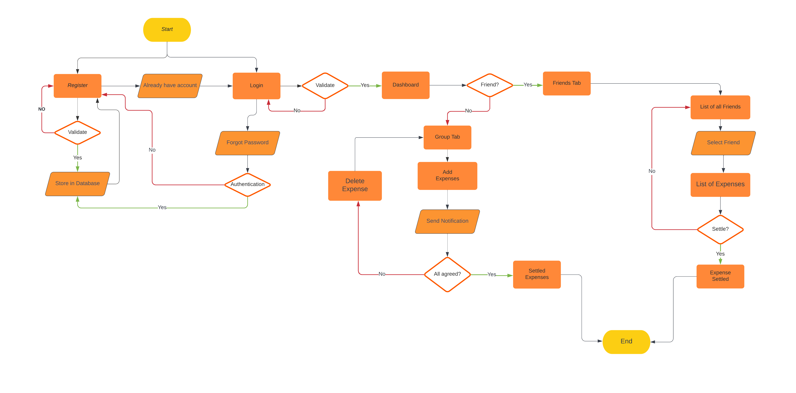
Flowchart
29

Slide 30
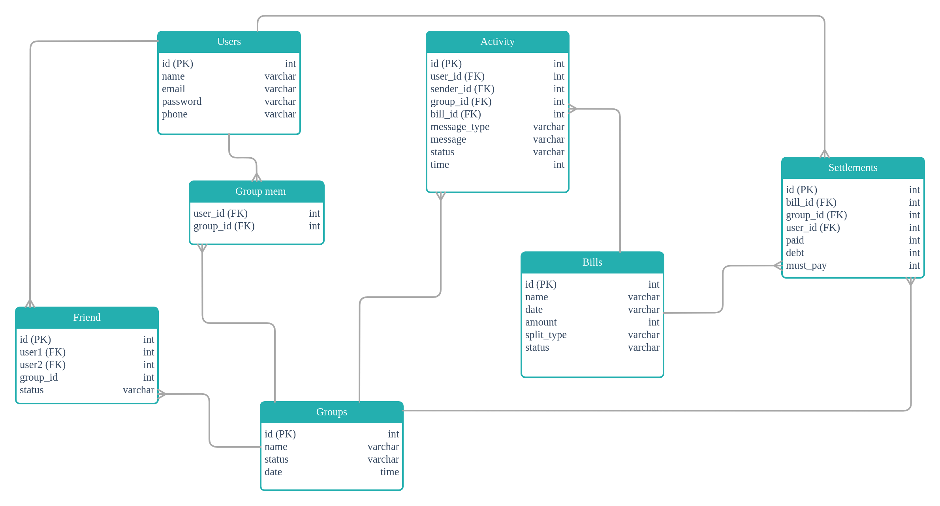
Data Model
30

Slide 31
Results
10
31

Slide 33
THANK YOU!
33

